Slide 1
Core Competencies and CSL
By Jen Johnson and Victoria Lorieau

Slide 2
Brief overview of the Redesigned Curriculum website
Curriculum tab drops down to subject areas, subdivided by Grade level
Curriculum is brought together using big ideas as opposed to checking details off of a list; the teacher focuses on the big ideas and incorporates content and competencies based on the needs of students
Based on a « know-do-understand » model; students will « know » the content, « do » the competencies and « understand » the big ideas
Changes to subject areas: Applied desgin, skills and technologies (ADST), Career Education and Physical and Health Education

Slide 3
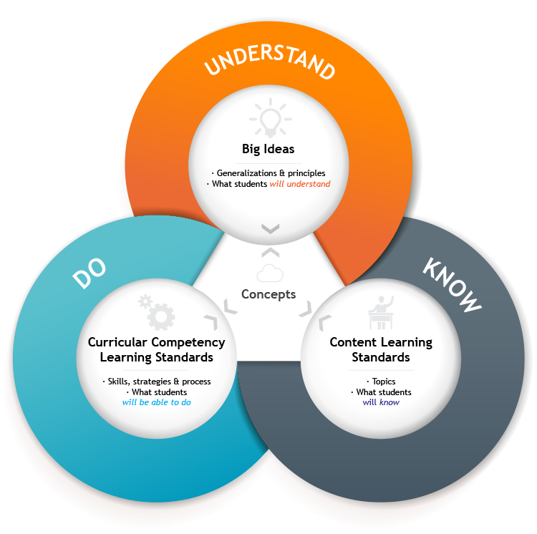

Slide 4
Core Competencies
Important skills integrated into all subject areas that students will need to develop in order to engage in deep and life-long learning –organized into three categories:
Communication
View the Communication Profiles and Illustrations »
Thinking
View the Creative Thinking Profiles and Illustrations »
View the Critical Thinking Profiles and Illustrations »
Personal and Social
View the Positive Personal & Cultural Identity Profiles and Illustrations »
View the Personal Awareness and Responsibility Profiles and Illustrations »
View the Social Responsibility Profiles and Illustrations »

Slide 5
Core Competency Examples
Victoria: Communication integrated with French and ADST
Jen: Creative thinking integrated with Science, Language Arts and Art

Slide 6
Communicating Student Learning (CSL)
CSL keeps the learner at the center
CSL is based on strengths, considers areas for growth and proposes a plan of action
The audience is the parent, the family, those outside of the classroom; the language is user-friendly

Slide 7
CSL shift in « reporting »
Two formal reports
Minimum of three ongoing communications, which may look like the following:
Goal-Setting Conferences
Student-Led Conferences
E-mail communication
Phone conversation
Digital or paper-based Student Portfolio sharing
Parent teacher meetings

Slide 8
CSL shift in « reporting » (continued)
No letter grades at the intermediate level
Anecdotal comments with a four-point « sliding scale »:
Beginning
Developing
Applying
Extending

